Slide 1
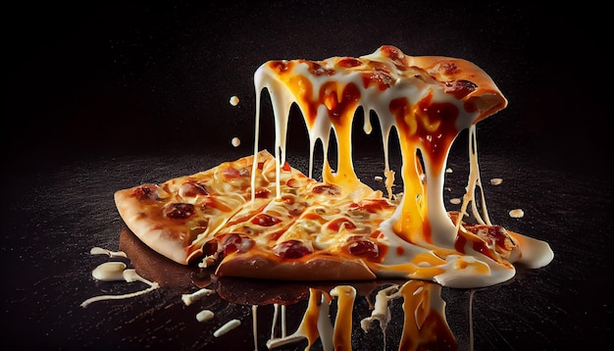
Pizza Sales Analysis using SQL
Akshat Kumar

Slide 2

Introduction
Welcome to the overview presentation of our comprehensive analysis of the Pizza Sales Dataset. In this presentation, we delve into the intricate details of our findings from the extensive dataset comprising 48,620 rows and 12 columns. Our analysis encapsulates various dimensions of pizza sales, including revenue, pizza popularity, size preferences, day of week sales trends, and monthly sales patterns.

Slide 3
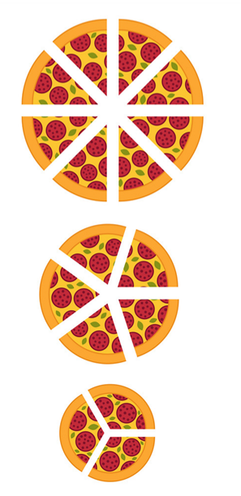
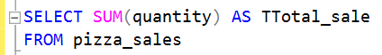

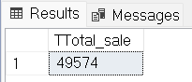

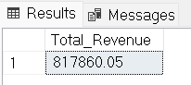
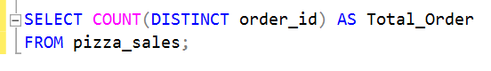

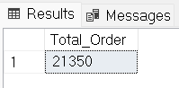
Insights
Total Pizza Sold: 50K
Total Revenue : 81786
Total Orders: 21350

Slide 4
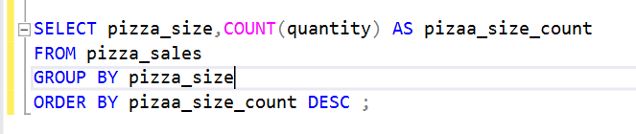
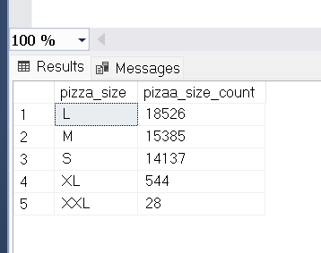
Pizza SALES: Size
HIGHEST SALES :
1. SIZE - L
2. SIZE - M
3. SIZE - S

Slide 5
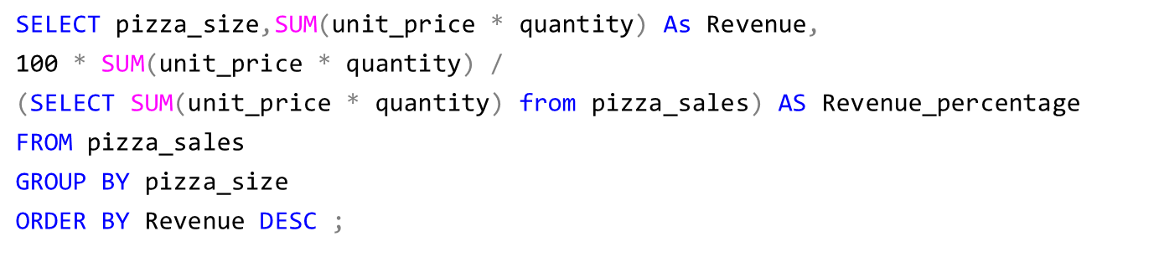
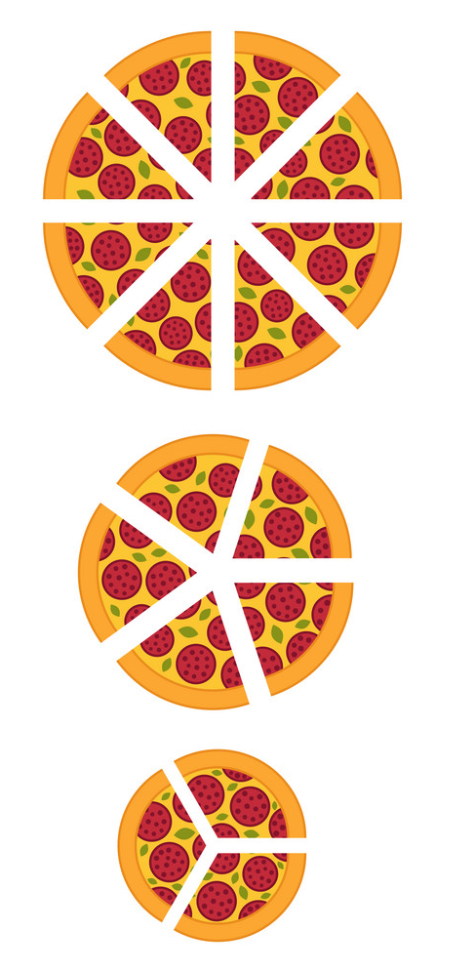
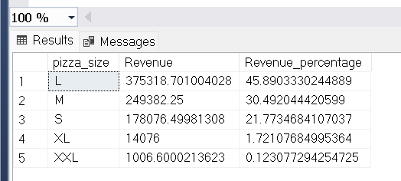
Revenue : PIZZA Size
HIGHEST REVENUE :
1. SIZE - L
2. SIZE - M
3. SIZE - S

Slide 6
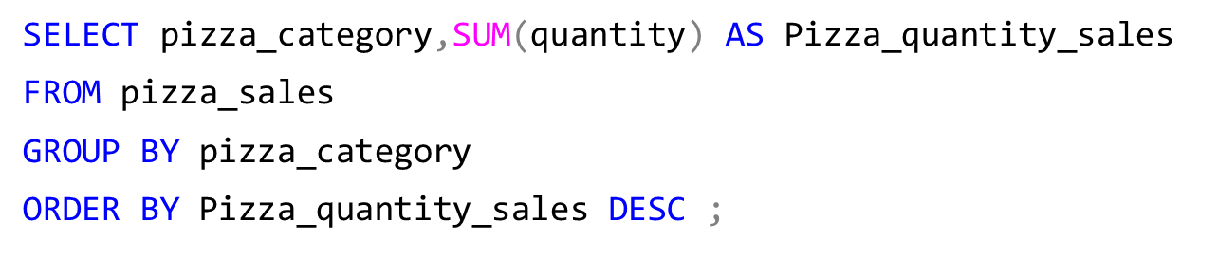

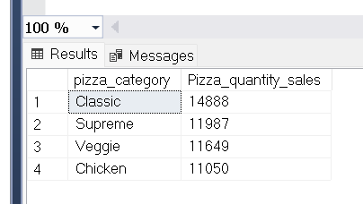
Pizza sales: Category
HIGHEST SALES CATEGORY:
1. CLASSIC
2. SUPREME
3. VEGGIE
4. CHICKEN

Slide 7
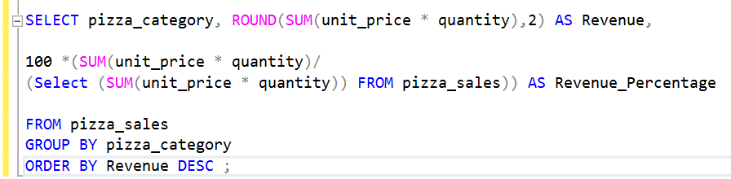
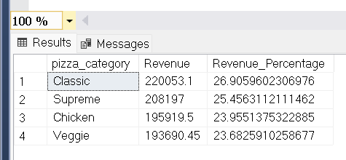

Revenue: Pizza Category
HIGHEST REVENUE CATEGORY:
1. CLASSIC
2. SUPREME
3. CHICKEN
4. VEGGIE

Slide 8
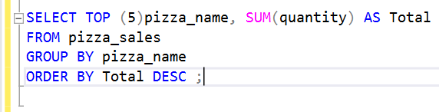

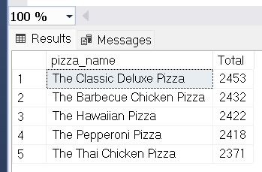
TOP 5 PIZZA BY SALES
TOP:
1. The Classic Deluxe Pizza
2. The Barbecue Chicken Pizza
3. The Hawaiian Pizza
4. The Pepperoni Pizza
5. The Thai Chicken Pizza

Slide 9
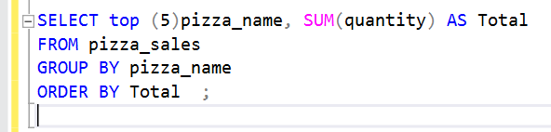
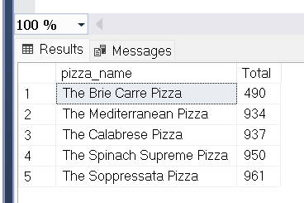

Bottom 5 pizza by sales
BOTTOM :
1. The Soppressata Pizza
2. The Spinach Supreme Pizza
3. The Calabrese Pizza
4. The Mediterranean Pizza
5. The Brie Carre Pizza

Slide 10

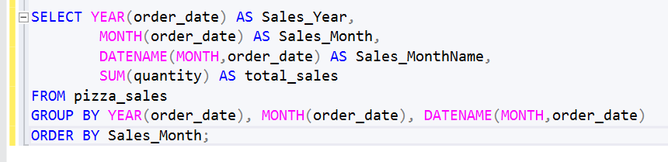
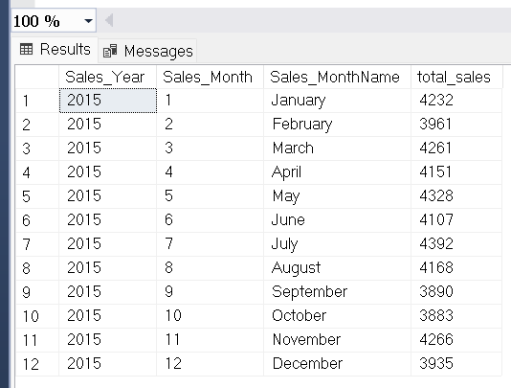
Monthly Sales
Monthly Sales

Slide 11
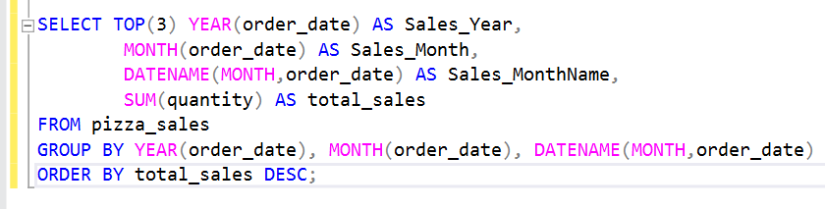
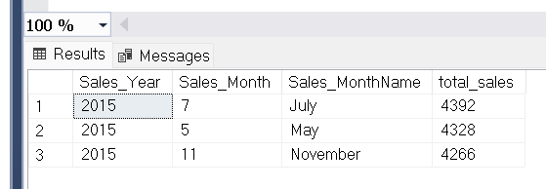
Monthly Sales Peak:
PEAK MONTHS :
1. JULY
2. MAY
3. NOVEMBER

Slide 12

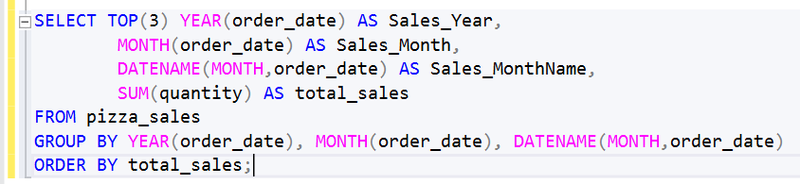
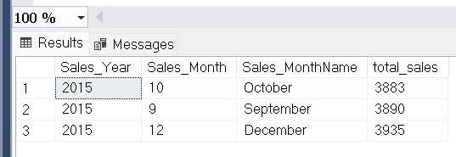
Monthly Sales Down
BOTTOM MONTHS :
1. DECEMBER
2. SEPTEMBER
3. OCTOBER

Slide 13
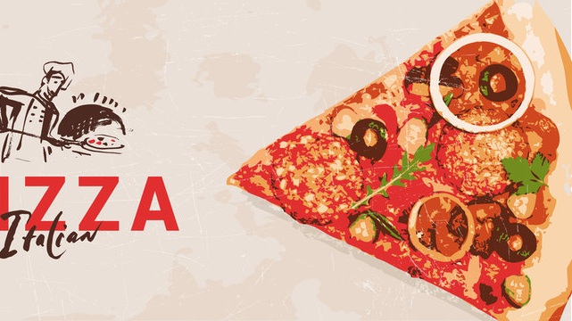
THANK YOU
Akshat Kumar
akshatukm@gmail.com
https://www.linkedin.com/in/imakshat-kumar/

